Slide 1

PROJECT ID: UT 08
EFFECT OF MINERAL OILS ON MICROSTRUCTURE OF CARBON STEELS DURING QUENCHING
UE17ME490: PROJECT PRESENTATION
AMITH KIRAN LOKESH: PES1201701641
VIKAS D S: PES1201700522
MD TAUSEEQ ZUMAN: PES1201701722
DINAKAR V: PES1201701884 GUIDE: CHAITRA RAO R

Slide 2

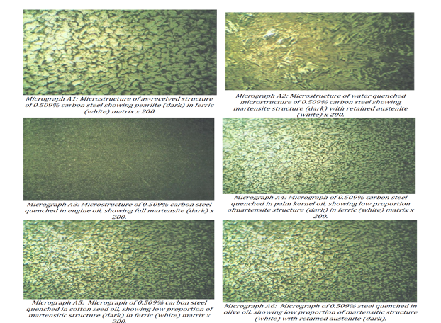
EFFECT OF ORGANIC OILS ON CARBON STEEL MICROSTRUCTURE DURING QUENCHING
INTRODUCTION
To study the different phases encountered during quenching of carbon steel in different oils and to draw conclusions for a suitable oil for quenching which would result in the suitable micro-structure and properties of the component being quenched.
Microstructures Formed

Slide 3
EFFECT OF ORGANIC OILS ON CARBON STEEL MICROSTRUCTURE DURING QUENCHING
INTRODUCTION
Why Quenching in Oil?
It transfers heat more quickly compared to other quenching media like molten salt or gas. Water-based caustic quenchants actually quench parts even more quickly than oil, but the severity with which caustics quench parts can cause significant distortion or even cracking for some materials.
What is Quenching?
Quenching is a type of metal heat treatment process. Quenching involves the rapid cooling of a metal to adjust the mechanical properties of its original state. To perform the quenching process, a metal is heated to a temperature greater than that of normal conditions, typically somewhere above its recrystallization temperature but below its melting temperature

Slide 4
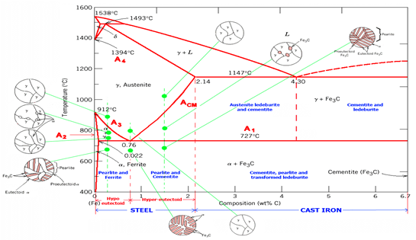
EFFECT OF ORGANIC OILS ON CARBON STEEL MICROSTRUCTURE DURING QUENCHING
INTRODUCTION
What is Phase Diagram? A phase diagram in physical chemistry, engineering, mineralogy, and materials science is a type of chart used to show conditions (pressure, temperature, volume, etc.) at which thermodynamically distinct phases (such as solid, liquid or gaseous states) occur and coexist at equilibrium.
Phase Diagram of Fe-C

Slide 5
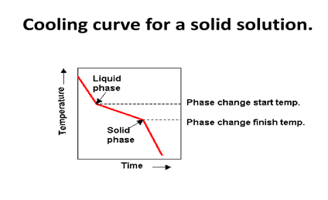
EFFECT OF ORGANIC OILS ON CARBON STEEL MICROSTRUCTURE DURING QUENCHING
INTRODUCTION
What are Cooling Curves? A cooling curve is a graphical plot of the changes in temperature with time for a material over the entire temperature range through which it cools. How they are plotted:
In this method, alloys with different compositions are melted and then the temperature of the mixture is measured at a certain time interval while cooling back to room temperature.
A cooling curve for each mixture is constructed and the initial and final phase change temperatures are determined. Then these temperatures are used for the construction of the phase diagrams

Slide 6
EFFECT OF ORGANIC OILS ON CARBON STEEL MICROSTRUCTURE DURING QUENCHING
LITERATURE
Journals:
M. Dauda1, L. S. Kuburi2, D. O. Obada3,* And R. I. Mustapha4 “Effects of various quenching media on mechanical properties of annealed 0.509wt%c –0.178wt%mn steel” Nigerian Journal of Technology (NIJOTECH) Vol. 34 No. 3, July 2015, pp. 506 – 512
Isamotu1* O.F., Jacob2 V.O., Oriaifo2 M.A., Raji3 K.M., Egu3 I.A., Aluko3 J.B Comparative analysis of Red oil and Palm kernel oil Quenching media for low carbon steel International Journal of Engineering Applied Sciences and Technology, 2020 Vol. 4, Issue 12, ISSN No. 2455-2143, Pages 67-76

Slide 7
EFFECT OF ORGANIC OILS ON CARBON STEEL MICROSTRUCTURE DURING QUENCHING
OBJECTIVES
To study how cooling at different rates and conditions have an effect on the micro-structure of the Carbon Steel sample.
These different conditions are being made possible by using different cooling oils and using their properties for our benefit.
To draw conclusion as to what changes made to the properties of the oils chemically can have an effect on the micro-structure of the Carbon Steel sample after quenching in that oil.

Slide 8
EFFECT OF ORGANIC OILS ON CARBON STEEL MICROSTRUCTURE DURING QUENCHING
METHODOLOGY
STEP 1:
Selection of one test sample of Carbon steel already having a certain Microstructure which can be further experimented on. (Preferably Cast Iron) Preparation of different samples having the exact same size and composition. Selection and procurement of oils having suitable characteristics helpful for quenching of the selected sample. STEP 2:
Study the base micro-structure under an electron microscope before quenching. Follow through with the quenching process after being heated to the exact same temperature as desired for the process to manufacture the selected component. Quenching in different oils and recording temperatures throughout the process. Plot cooling curves for quenching using each different oil selected.

Slide 9
EFFECT OF ORGANIC OILS ON CARBON STEEL MICROSTRUCTURE DURING QUENCHING
METHODOLOGY
STEP 3:
Analyse the resultant microstructures obtained and the cooling curves being followed in each case. Standard Phase Diagram (Iron - Carbon Diagram) can be used for comparison as to see what curves are being followed and what type of reaction is happening in each case. Studying the resultant micro-structure and their useful properties for different applications. Also Compare with standard cooling curves of the same sample in air or water and those resultant micro-structures. STEP 4: Draw conclusions as to which oils are preferable to obtain which microstructures and then to infer what modifications can be made to the cooling curves to obtain more desirable resultant micro-structures. To obtain such cooling curves what changes can be made chemically to the oils being used.

Slide 10
EFFECT OF ORGANIC OILS ON CARBON STEEL MICROSTRUCTURE DURING QUENCHING
METHODOLOGY AND EXPECTED OUTCOMES
STEP 5:
Concluding the experimentation by plotting the results in a phase diagram format for quenching using different oils and if possible to develop a standard oil for quenching for that particular application which we are targeting. EXPECTED OUTCOMES
To develop a microstructures of Carbon steel by quenching with different Oils and plotting the results in a phase diagram format for quenching using different oils (Palm kernel oil , Engine oil, Olive oil, Cotton Seed Oil) .

Slide 11
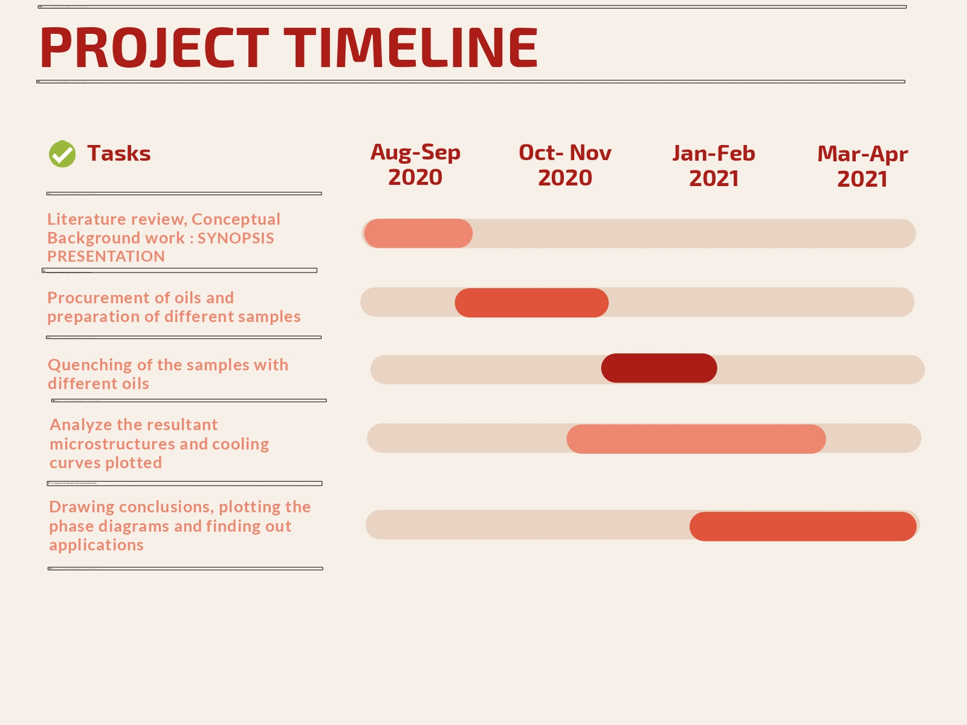
EFFECT OF ORGANIC OILS ON CARBON STEEL MICROSTRUCTURE DURING QUENCHING
PROJECT TIMELINE

Slide 12
THANK YOU
Project ID: UT 08
AMITH KIRAN LOKESH (PES1201701641) VIKAS DS (PES1201700522) MD TAUSEEQ ZUMAN ( PES1201701722 DINAKAR V (PES1201701884)

